Slide 1

Vehicle Sales and Market Trends

Slide 2
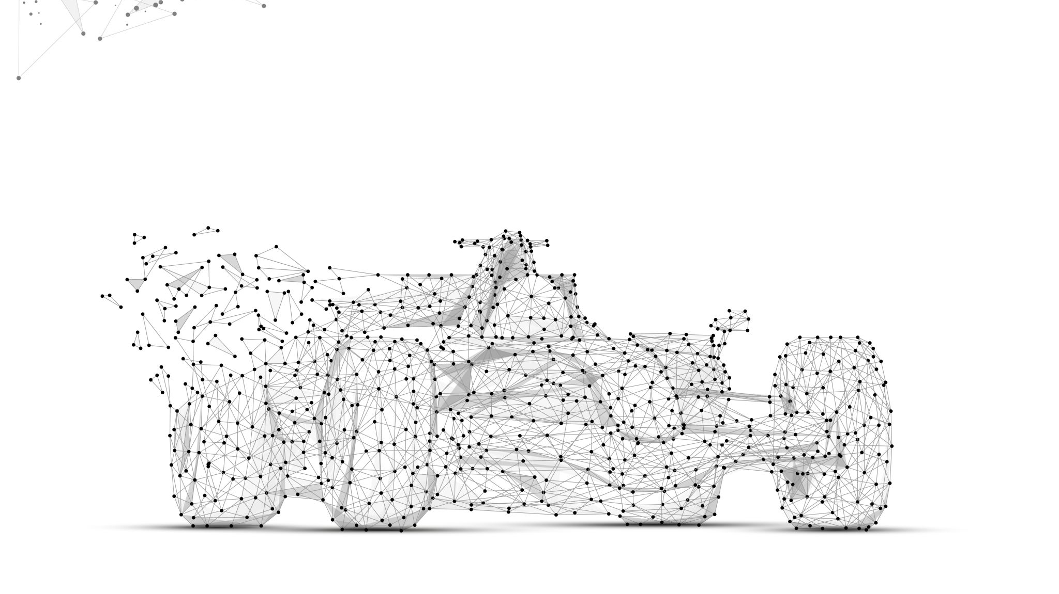
Overview Of Dataset
The "Vehicle Sales and Market Trends Dataset" signifies a large trove of information with respect to sales and transactions related to vehicles. These data include year, make, model, trim, body type, transmission type, VIN (vehicle identification number), state of registration, condition rating, odometer readings, of both the outside and inside colors, seller information, MMR values, selling prices, and sale dates.
https://www.kaggle.com/datasets/syedanwarafridi/vehicle-sales-data

Slide 3
Description of Dataset
The data in the Vehicle Sales and Market Trends Dataset provide rich transactional information related to vehicle sales, including vehicle specifications, sales transactions, and market valuations, so comprehensive analysis of the Automotive Market is enabled.
Vehicle Characteristics: With attributes like year, make, model, trim, body type, and transmission; allows categorization of vehicles and a better understanding of market demand toward different types. Transaction Information: With sellingprice, saledate, and seller; provides insights for every vehicle and study of market price trends. Market Trends: mmr (Manheim Market Report) values provide estimated market prices that can assist in setting price benchmarks; useful to infer market fluctuations or depreciation trends.

Slide 4
Description of Dataset
# | Column | Non-Null Count | Data Type
0 | year | 558,837 | int64
1 | make | 548,536 | object
2 | model | 548,438 | object
3 | trim | 548,186 | object
4 | body | 545,642 | object
5 | transmission | 493,485 | object
6 | vin | 558,833 | object
7 | state | 558,837 | object
8 | condition | 547,017 | float64
9 | odometer | 558,743 | float64
10 | color | 558,088 | object
11 | interior | 558,088 | object
12 | seller | 558,837 | object
13 | mmr | 558,799 | float64
14 | sellingprice | 558,825 | float64
15 | saledate | 558,825 | object

Slide 5

MLS Well Defined Problem
Develop a predictive model to estimate a vehicle's selling price based on its specifications, condition, mileage, and market trends.
To be more effective in their decision-making, a correct estimate of vehicle selling prices is of paramount importance to buyers, sellers, and dealers. Hence, the objective is to make an ML model that will take into consideration historical sales data of vehicles for safe price prediction using some characteristics, say, make, model, year, condition, mileage, and market trends.

Slide 6
Data Collection
EDA
Preprocessing
Predictions & Insights
Feature Engineering
Model Evaluation
Model Selection & Model Training

Slide 7
